Slide 1

Object oriented programming project
Topic : Contact Management System
Submitted to:
Mr. Arpit Deo
Submitted by:
EN20CS301309 Prateek Shah EN20CS301321 Priyanshi Agrawal
EN20CS301352 Rishika Jain

Slide 2
Introduction
The Contact Management System project is designed in ‘C++’ language.
This system is based on a concept to store and generate all the records of the Person or an Organization’s Contact.
The user can add/view/search/edit/delete the contact details.

Slide 3

Objectives
The project is mainly based on following objectives:
Using C++ programming and its features.
Implementing features like control statement, classes and objects and file handlings.
Resource reusability (user defined function).
To concise the memory of program as far as possible.
To get an idea about making a simple project using C++ and oops.

Slide 4
What is OOP?
Combines attribute with functions/methods into a unit called Object.
Class-based language.
Data attribute/functions are defined as blueprint for an object.
multiple object instantiated/represented from same class.
Popular example of class-based OOP language include Java, Python, C++, etc.

Slide 5
Concepts implemented in the project-
Classes and objects
Namespace
Header files
File handling

Slide 6
File Handling In C++
Files store data permanently in storage device.
File handling provides mechanism to store output of a program.
C++ provides a set of file handling methods (ifstream, ofstream and fstream).
These classes are derived from fstreambase and corresponding iostream class.
These classes manages disk files, therefore compulsory to include in program which uses files.

Slide 7
In C++, files are mainly dealt by using three classes fstream, ifstream, ofstream.
Ofstream: This Stream class signifies the output file stream and is applied to create files for writing information to files
Ifstream: This Stream class signifies the input file stream and is applied for reading information from files
Fstream: This Stream class can be used for both read and write from/to files.

Slide 8
FEATURES:
Add a new Contact
List all Contacts
Search for Contact
Edit a Contact
Delete a Contact
Exit

Slide 9
Start
Take ch as user input
No
Yes
Macro Flowchart
if ch==1
Add new Contact
No
Yes
if ch==2
Show all Contacts
No
Yes
if ch==3
Search a Contact
No
Yes
if ch==4
Edit a Contact
No
Yes
if ch==5
Delete a Contact
No
No
Yes
if ch==6
Stop

Slide 10
Add a new Contact
1.
The user can add new contacts with information such as name, phone number, address.

Slide 11
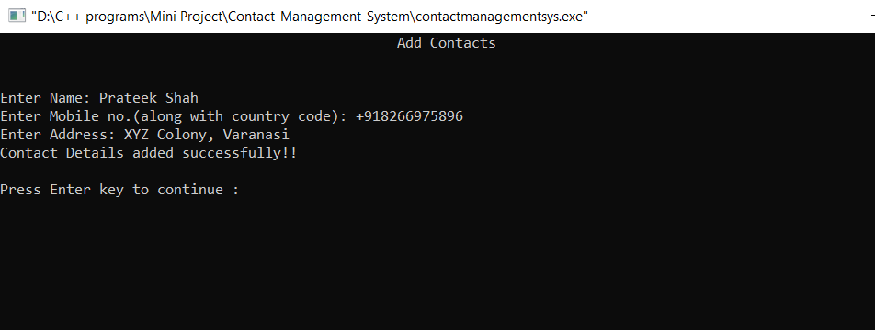
Sample Output:

Slide 12
2.
Show all Contacts
This function lists all the contact details which is currently present in the file.

Slide 13
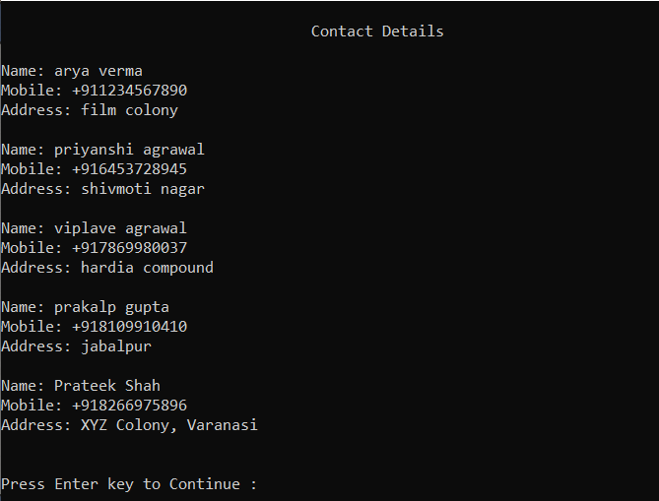
Sample Output:

Slide 14
3.
Search for Contact
The user can search through the already existing contact details by name/phone no./address.

Slide 15
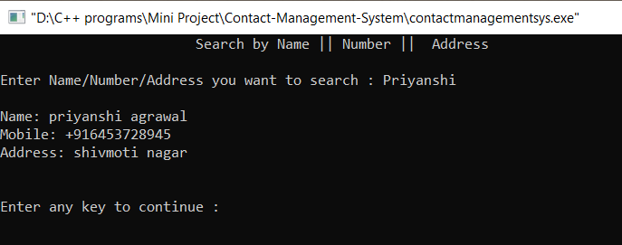
Sample Output:

Slide 16
4.
Edit a Contact
The user can edit/update already existing contact details.

Slide 17
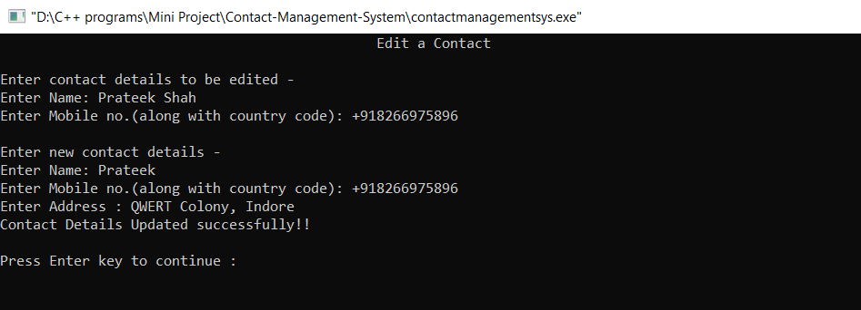
Sample Output:

Slide 18
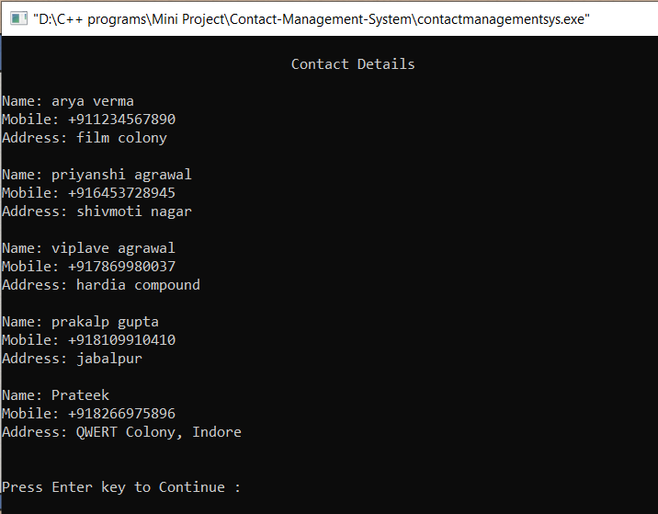
Contacts List after editing:

Slide 19
5.
Delete a Contact
The user can delete the contact details of a person.

Slide 20
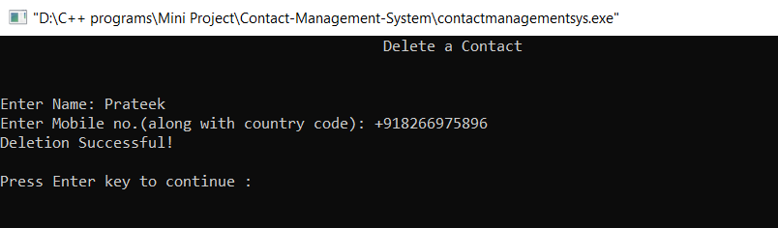
Sample Output:

Slide 21
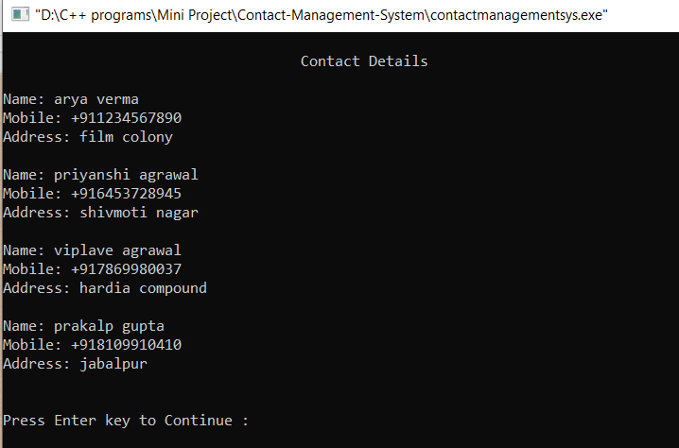
Contacts List after Deletion of a contact:

Slide 22
Compatibility
Other OS
Windows
It is fully compatible with windows OS.
Might not work on other OS.(Because functions of windows.h header file might not work in other OS)

Slide 23
Limitations and drawbacks:
GUI
OS
Phone no. Validation
Phone number is not validated.
Not compatible with any OS other than windows.
There is no GUI because of which it is not very user friendly.

Slide 24
Scope of improvement
 | GUI can be added.
 | Phone number validation can be added.
 | Can be made compatible with more number of OS.
 | Contact details can be arranged in alphabetical order by names.
 | We can also use any other kind of DBMS for proper management of data.
Notes
Other that these points there is more scope of improvement in this project. If you all want to suggest any?

Slide 25
References:
www.cppreference.com
www.stackoverflow.com
www.geeksforgeeks.org

Slide 26
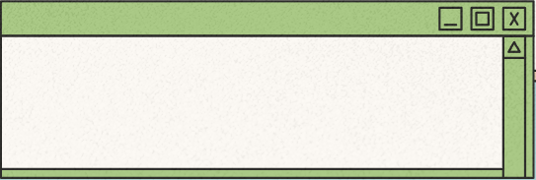
Thank You !!
For source code, you can visit:
https://github.com/Prateek027-S/Contact-Management-System

